Slide 1
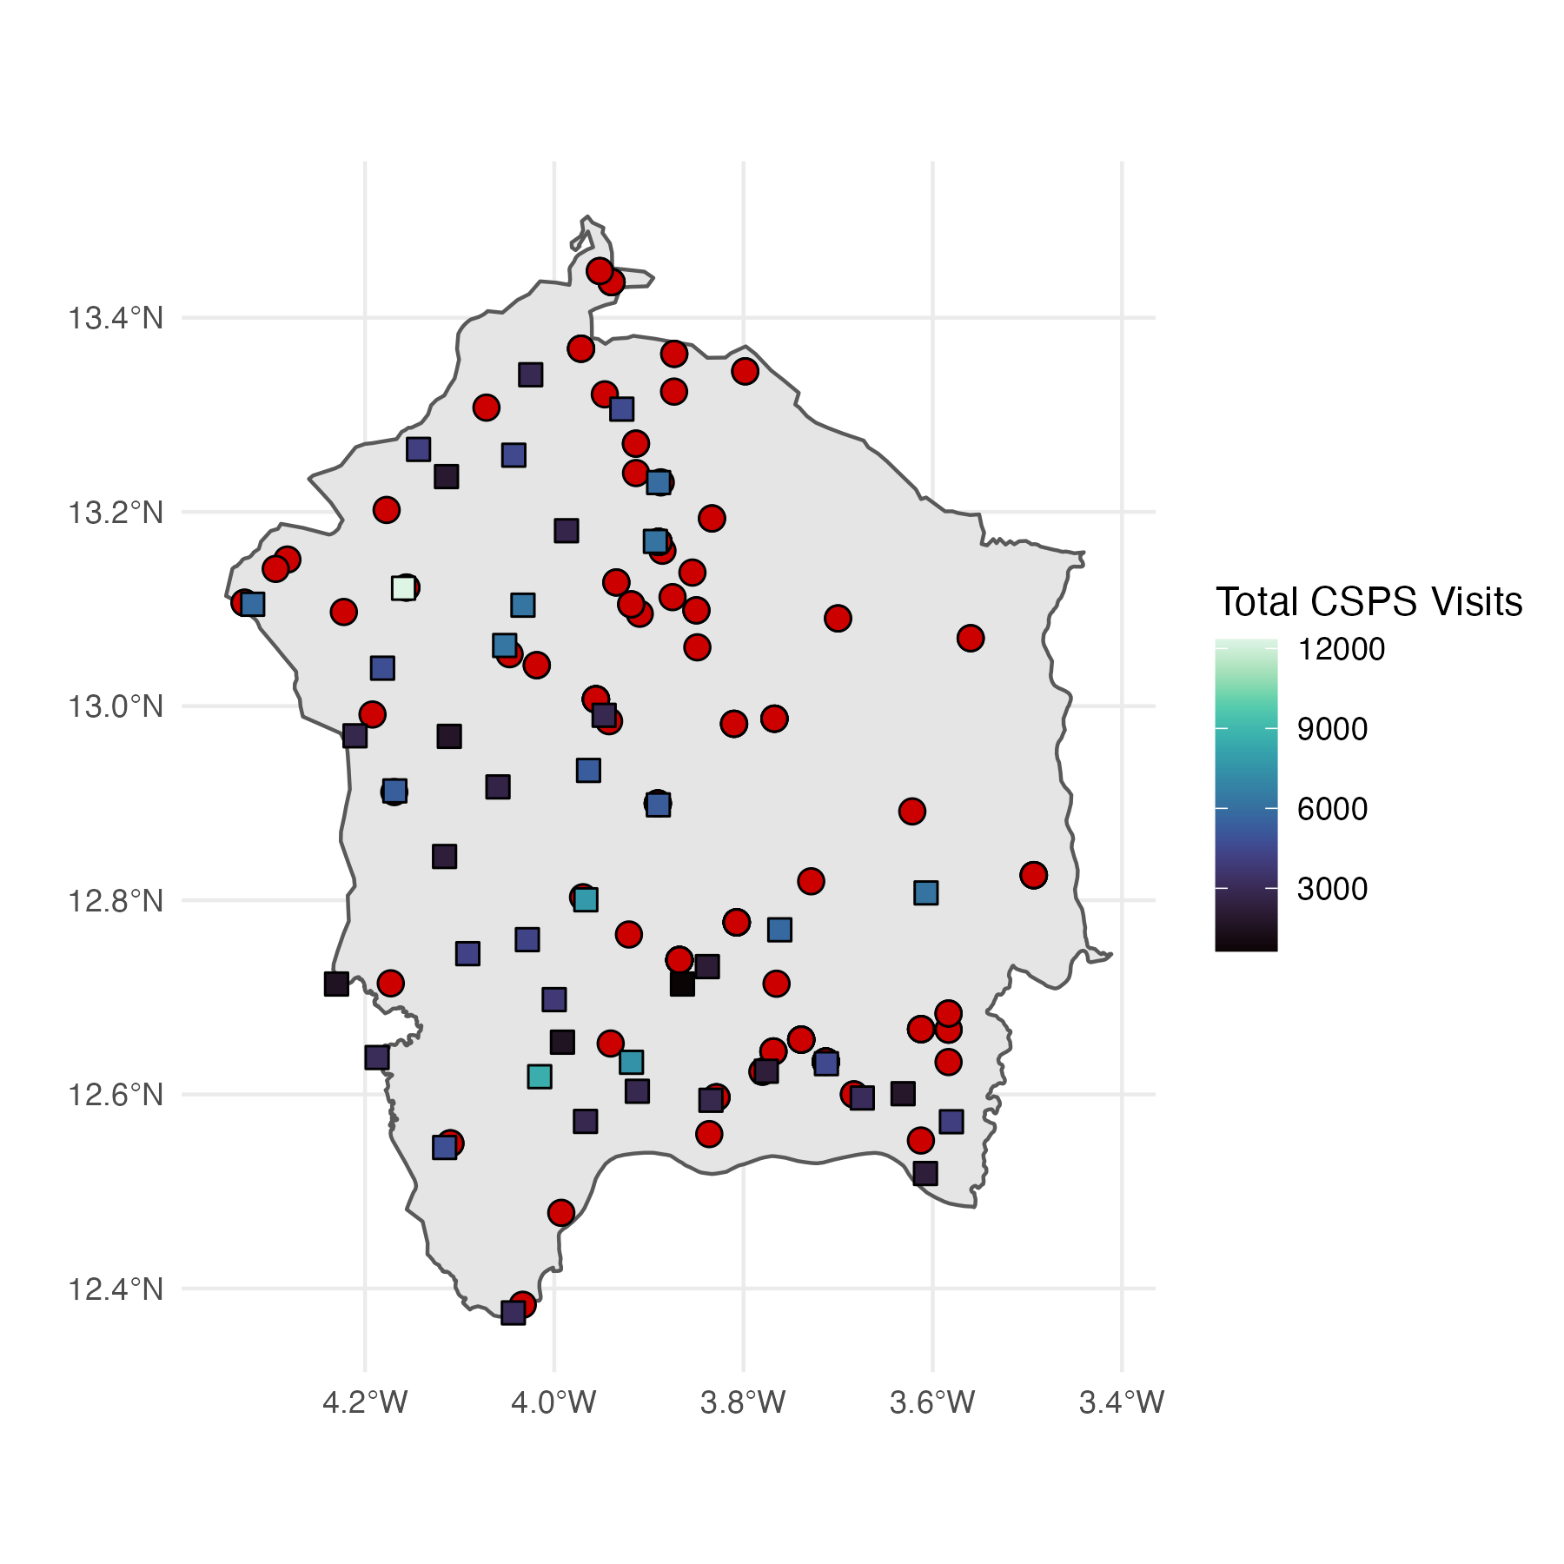
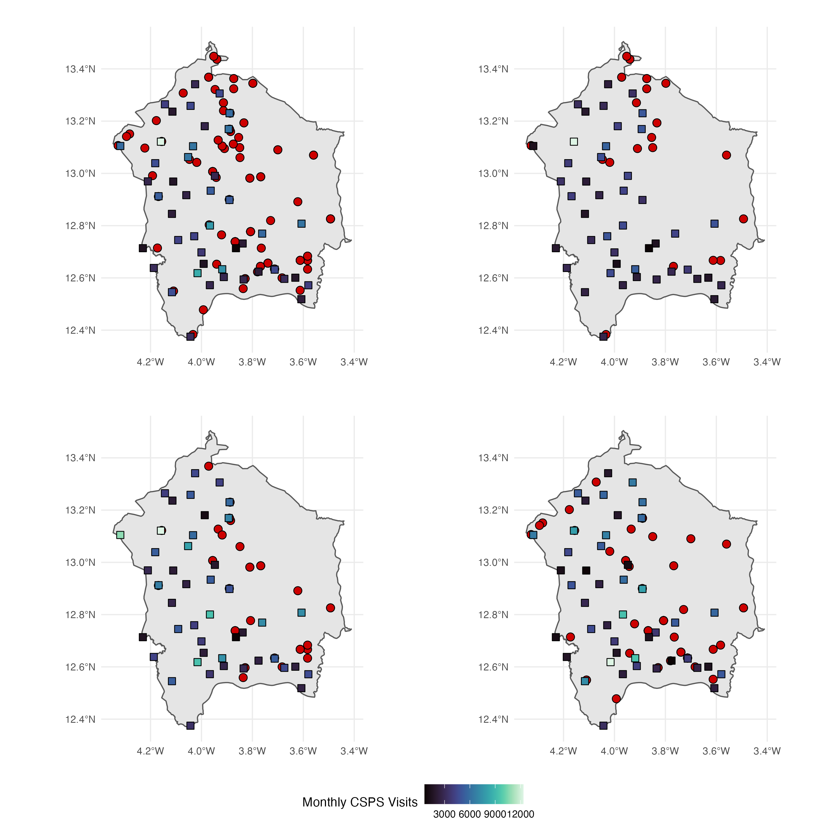
A. 2020-2022, n=153 events
B. 2020, n=26 events
C. 2021, n=42 events
D. 2022, n=85 events

Slide 2
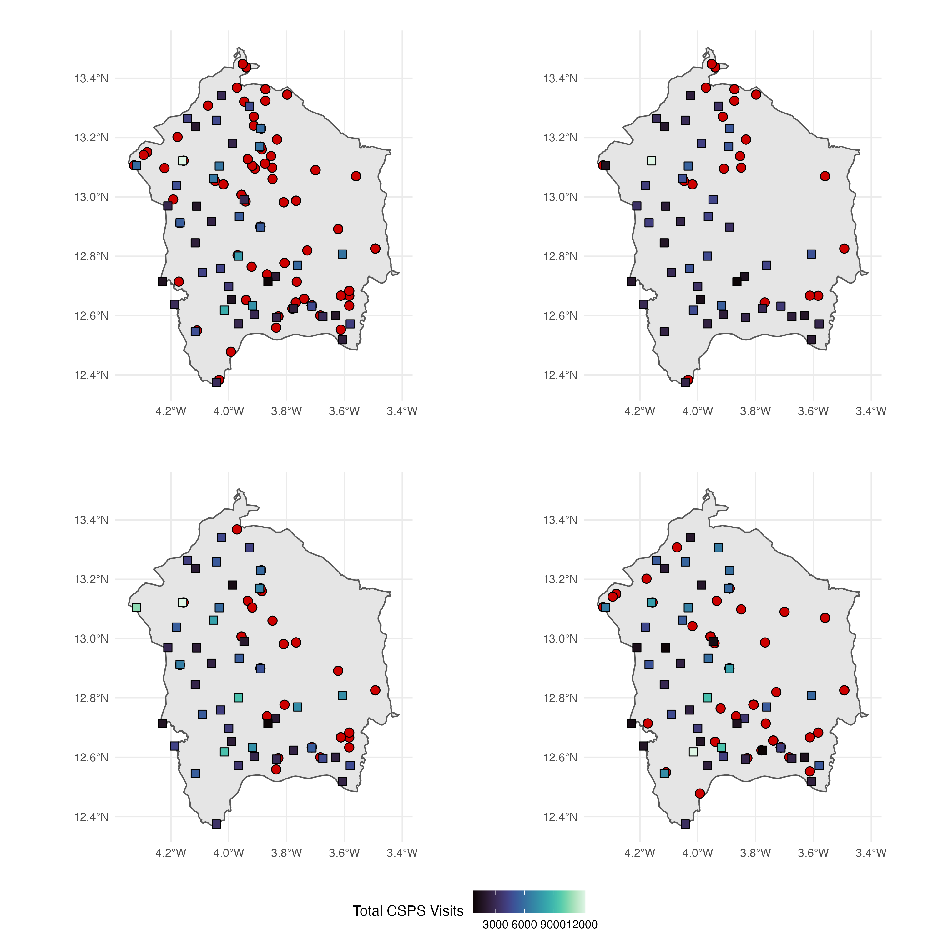
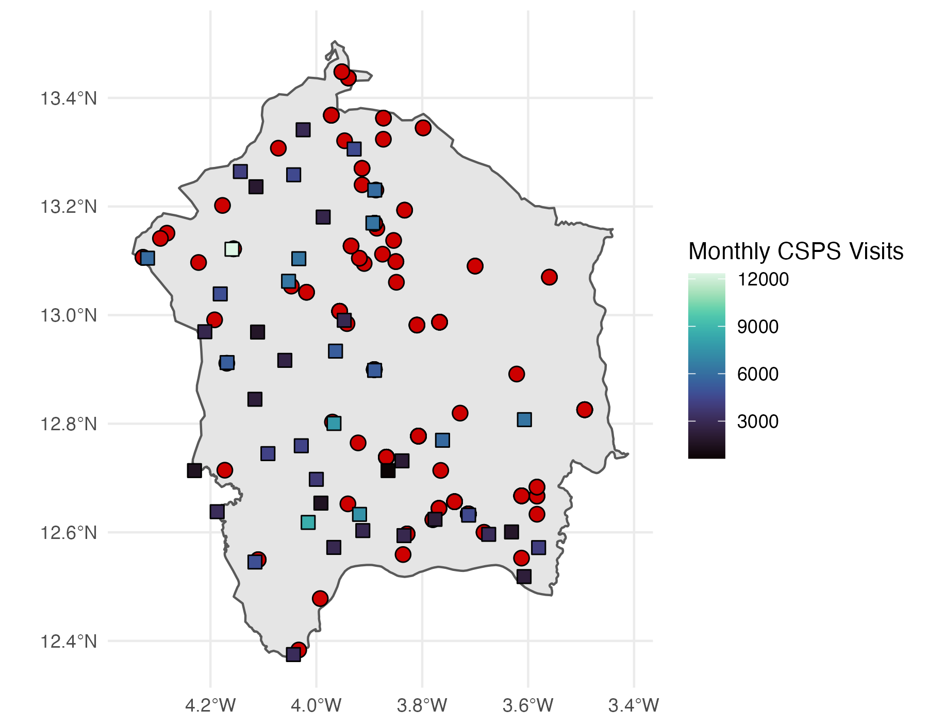
A. 2020-2022, n=153 events
B. 2020, n=26 events
C. 2021, n=42 events
D. 2022, n=85 events

